Slide 1
Simultaneous Morse Code Telegraphy using Radio Waves and Arduino UNOs
Vivswan Shah and Luigi Erba

Slide 2

What is Morse Code Telegraphy?
Samuel Morse and the Morse Code.
The telegraph machine.
Evolution and Development of the Telegraph machine.
Ref: White, T. H. (2005). Cyclopedia of Applied Electricity (1911 ed., Vol. 6). American School of Correspondence. Retrieved December 11, 2018

Slide 3

What is a Good Communication System?
Allows communication free of interruptions.
Allows simultaneous communication. ⇆
Features verification of delivery. ✓
Has little latency for a seamless communication experience. 🕐

Slide 4
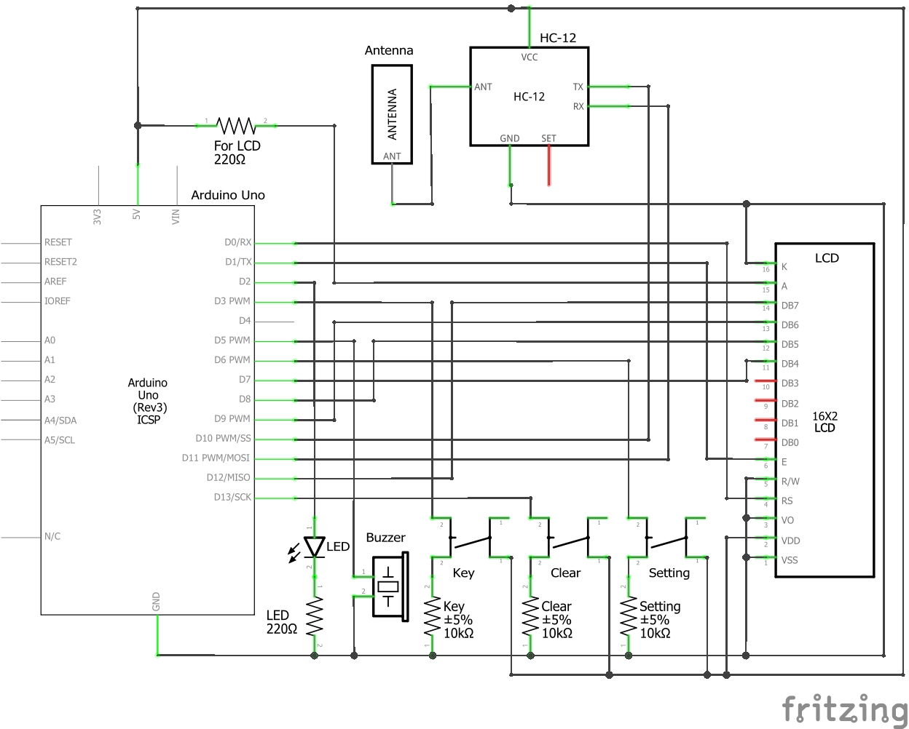
Wireless Simultaneous Morse Code Telegraphic Device
Arduino UNO
Breadboard
Breadboard-compatible components:
1x 16x2 LCD Display Module
1x HC-12 Wireless Module 1000m
1x HC-12 Compatible Antenna
1x Buzzer
1x LED Light
3x Tactile Switches
2x 220-ohm Resistors
3x 10k-ohm resistors
43x Male/Male Jumper Wires

Slide 5
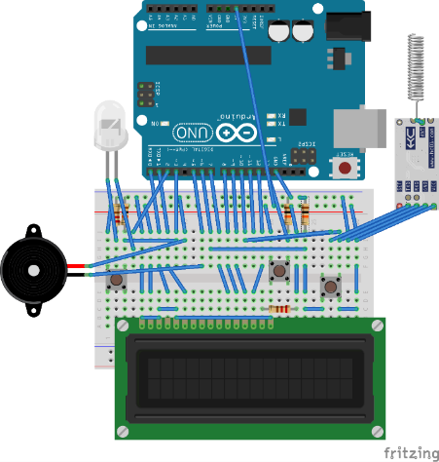
***---***

Slide 6
- **** *- -* -*- -*-- --- **-
T h a n k Y o u

